Slide 1


Slide 2

Restaurant Management Point Of Sale System

Slide 3

TEAM
MEMBERS
Supervisor
Mr. Peranantham Urithiran
Student Name | Student ID
S.M.C.M. Suraweera (Leader) | MMW-21-B1-32
T.P.G.R. Rangana | SOF-21-B1-20
K.K.T.D. jayathilaka | NET-21-B1-36
W.A.L.K.Jayaweera | SOF-21-B1-29
T.M.D. Minosha | SOF-21-B1-13
SmartBill Point of Sale System for Restaurant Management

Slide 4
QUICK
INTRODUCTION
01
A windows form application for a restaurant management POS system
02
Efficient Menu Organization
03
Comprehensive Item Control
04
Insightful Reporting and Analytics
05
Streamlined Staff Management
SmartBill Point of Sale System for Restaurant Management

Slide 5
MAIN
STAKEHOLDERS
01
Admin
02
Cashier
03
Server
04
Chef
05
Customer
SmartBill Point of Sale System for Restaurant Management

Slide 6
USER
STORIES
Category Management (By Admin):
Admins can efficiently organize items by creating, updating, and deleting menu categories to reflect changes in the restaurant's menu.
Item Management (By Admin):
Admins have the ability to add, update, and remove menu items, ensuring accurate and relevant information in the restaurant's offerings.
Reporting and Analytics (By Admin):
Admins can gain insights into restaurant performance by viewing daily sales reports and analyzing sales data.
Staff Management (By Admin):
Admins can manage the staff effectively by adding, updating, and removing members, assigning roles as Cashier, Waiter, or Chef.
Order Management (By Cashier):
Cashiers can efficiently handle customer orders, customizing them based on preferences and marking them.
Billing and Invoicing (By Cashier):
Cashiers can manage bills by splitting them among multiple customers
SmartBill Point of Sale System for Restaurant Management

Slide 7
MAIN
FUNCTIONS
01
Category Management (By Admin)
02
Item Management (By Admin)
03
Reporting and Analytics (By Admin)
04
Staff Management (By Admin)
05
Order Management (By Cashier)
06
Billing and Invoicing (By Cashier)
SmartBill Point of Sale System for Restaurant Management

Slide 8
IDENTIFIED
PROBLEMS
01
Admins face challenges in efficiently updating and deleting menu categories, leading to potential confusion.
02
Ensuring accurate and relevant menu item information is challenging, requiring a streamlined process for updates and removals.
03
Admins find it challenging to generate and interpret daily sales reports and analyze data by category and item.
04
Admins struggle with accurate staff addition, updates, and role assignments, impacting the efficiency of the staff hierarchy.
SmartBill Point of Sale System for Restaurant Management

Slide 9
MAIN
OBJECTIVES
To streamline and enhance the overall efficiency of restaurant operations by providing a robust Point of Sale (POS) system that facilitates seamless menu management, ensures accurate item data, enables insightful reporting and analytics, and optimizes staff management, ultimately leading to improved customer service and business performance.
SmartBill Point of Sale System for Restaurant Management

Slide 10
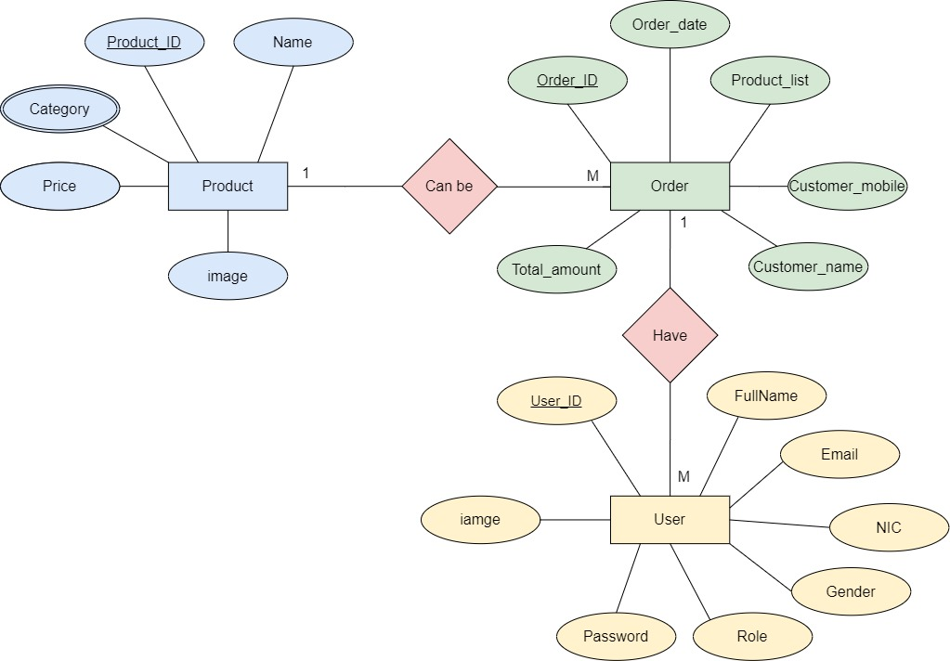
SYSTEM ER DIAGRAM
SmartBill Point of Sale System for Restaurant Management

Slide 11
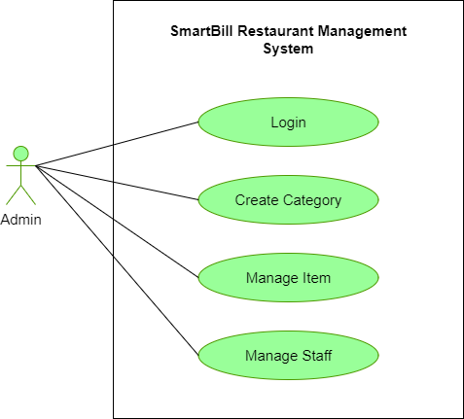
USECASE DIAGRAMFOR ADMIN
SmartBill Point of Sale System for Restaurant Management

Slide 12
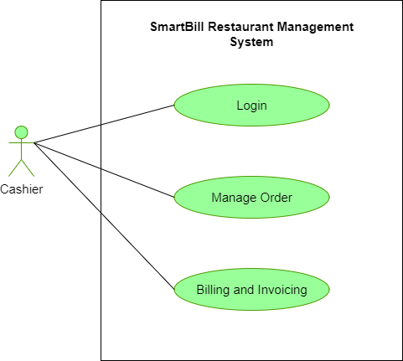
USECASE DIAGRAM FOR CASHIER
SmartBill Point of Sale System for Restaurant Management

Slide 13
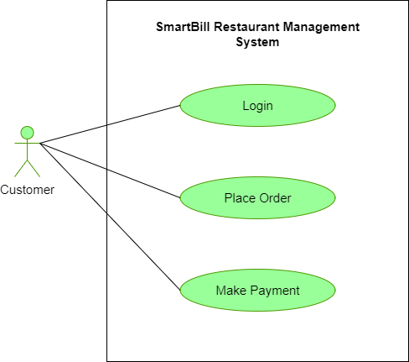
USECASE DIAGRAM FOR CUSTOMER
SmartBill Point of Sale System for Restaurant Management

Slide 14
REQUIREMENTS
Non-Functional Requirements
Functional Requirements
System Requirements
Performance
Category Management
High Processing Speed
Reliability
Item Management
High capacity​
Security
Reporting and Analytics
Stable and secure internet connection
Scalability
Staff Management
Integration with payment gateways
Usability
Order Management
Compliance with data protection regulations
Billing and Invoicing
SmartBill Point of Sale System for Restaurant Management

Slide 15



TECHNOLOGIES TO BE USED
Front End
.NET Framework
Back End
C#
Database
SQL Server Management Studio
SmartBill Point of Sale System for Restaurant Management

Slide 16
DATABASE CREATION

Slide 17
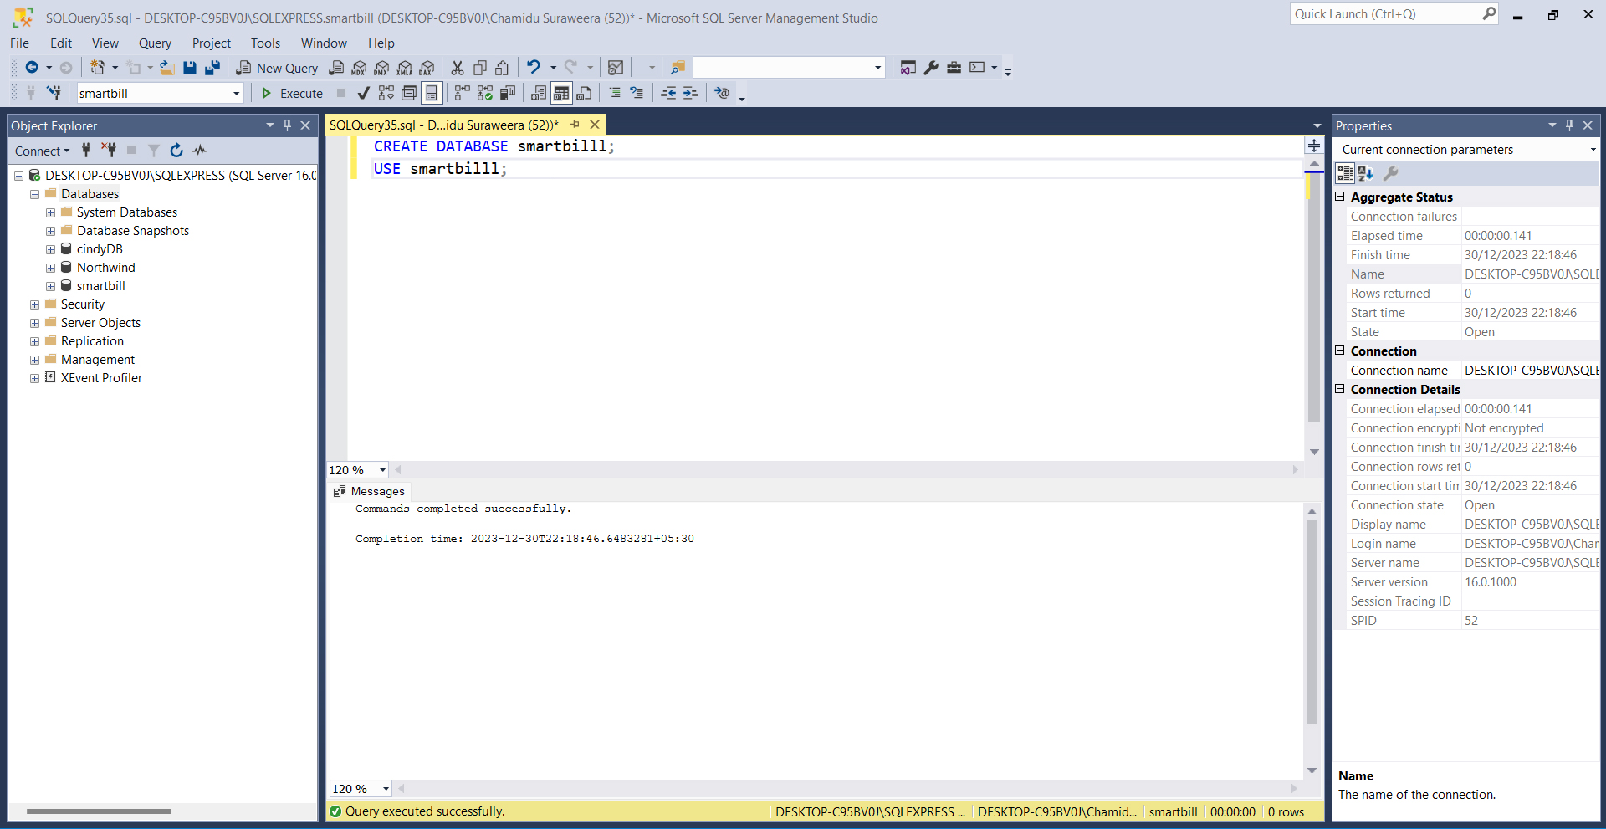
CREATE DATABASE
SmartBill Point of Sale System for Restaurant Management

Slide 18
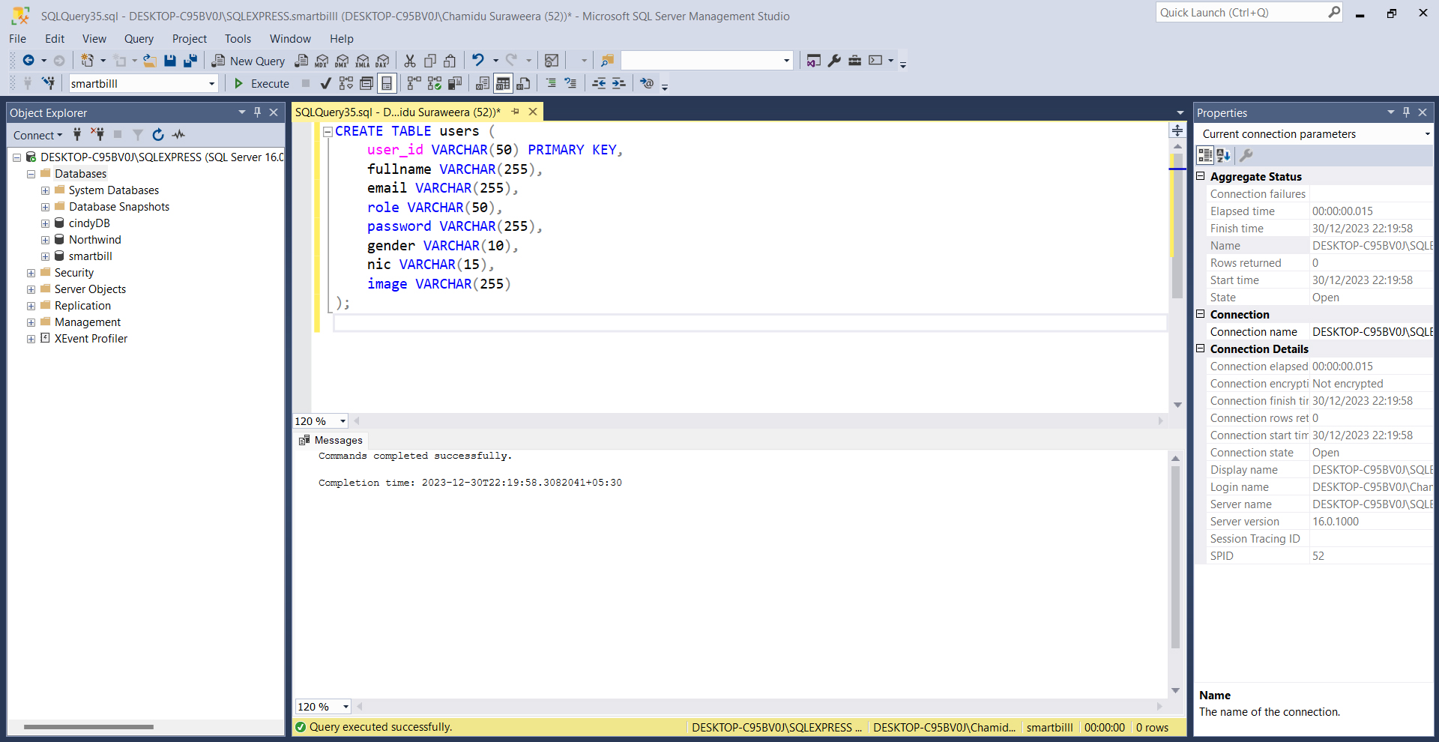
CREATE TABLE - USERS
SmartBill Point of Sale System for Restaurant Management

Slide 19
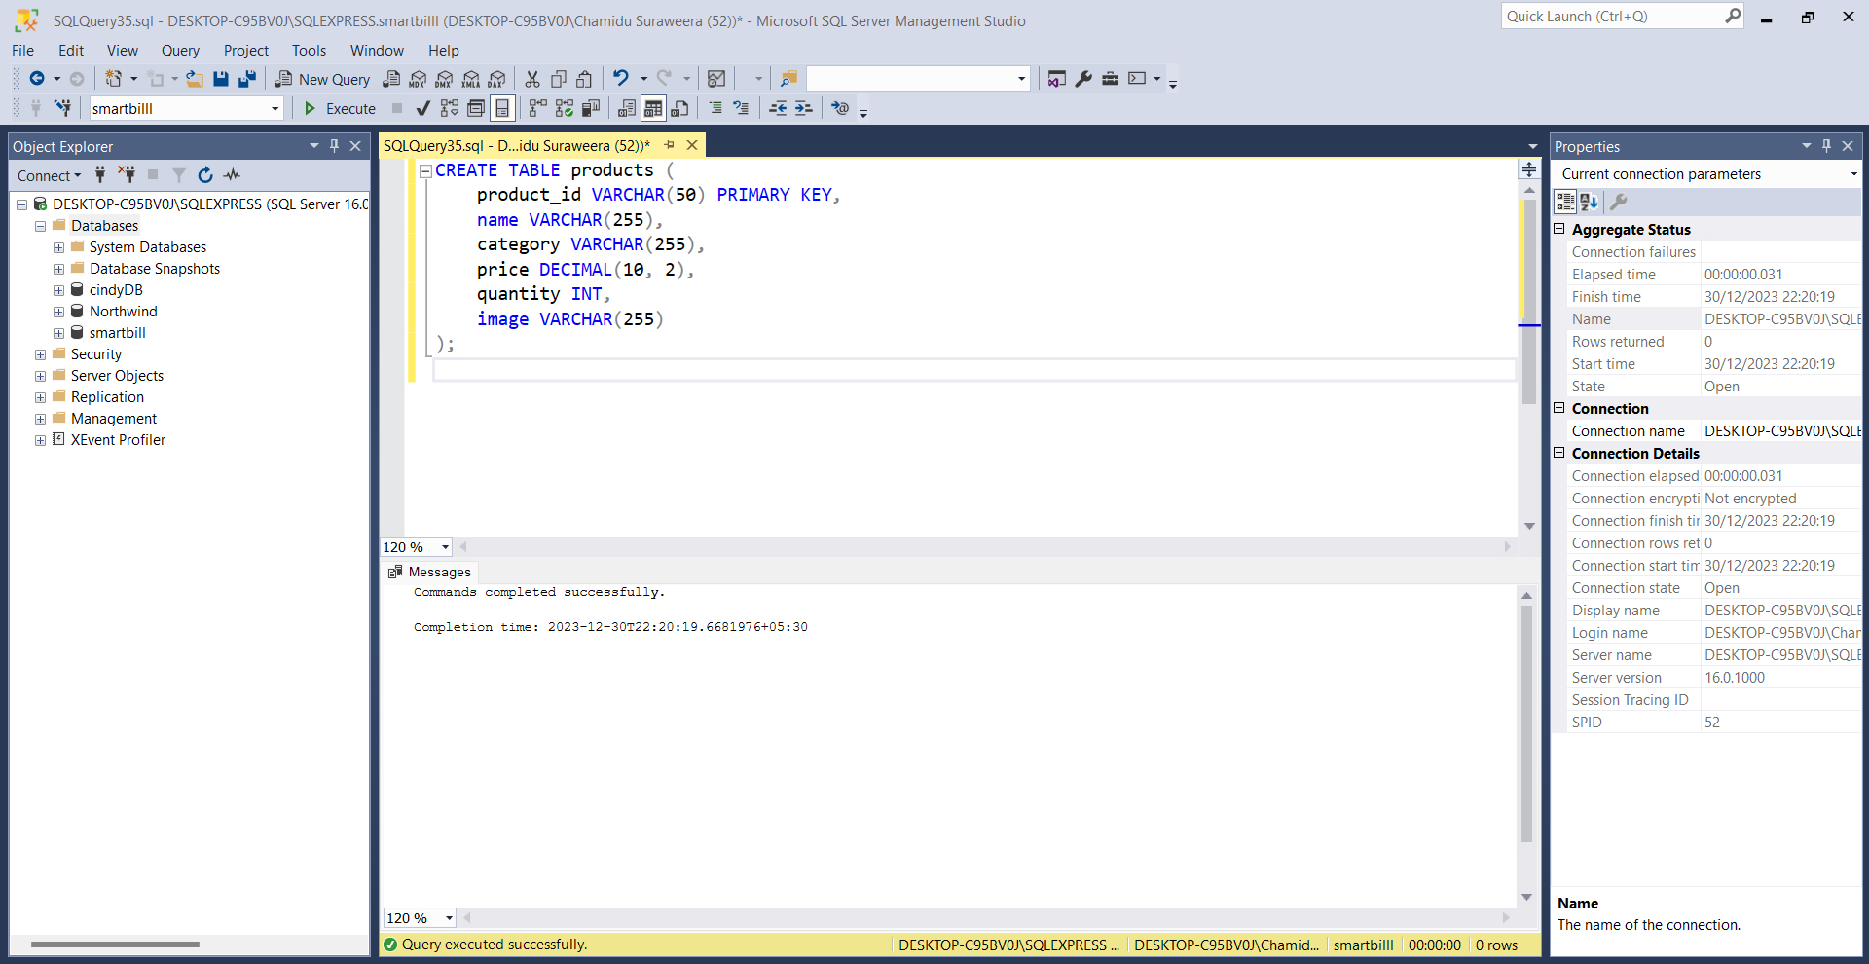
CREATE TABLE - PRODUCTS
SmartBill Point of Sale System for Restaurant Management

Slide 20
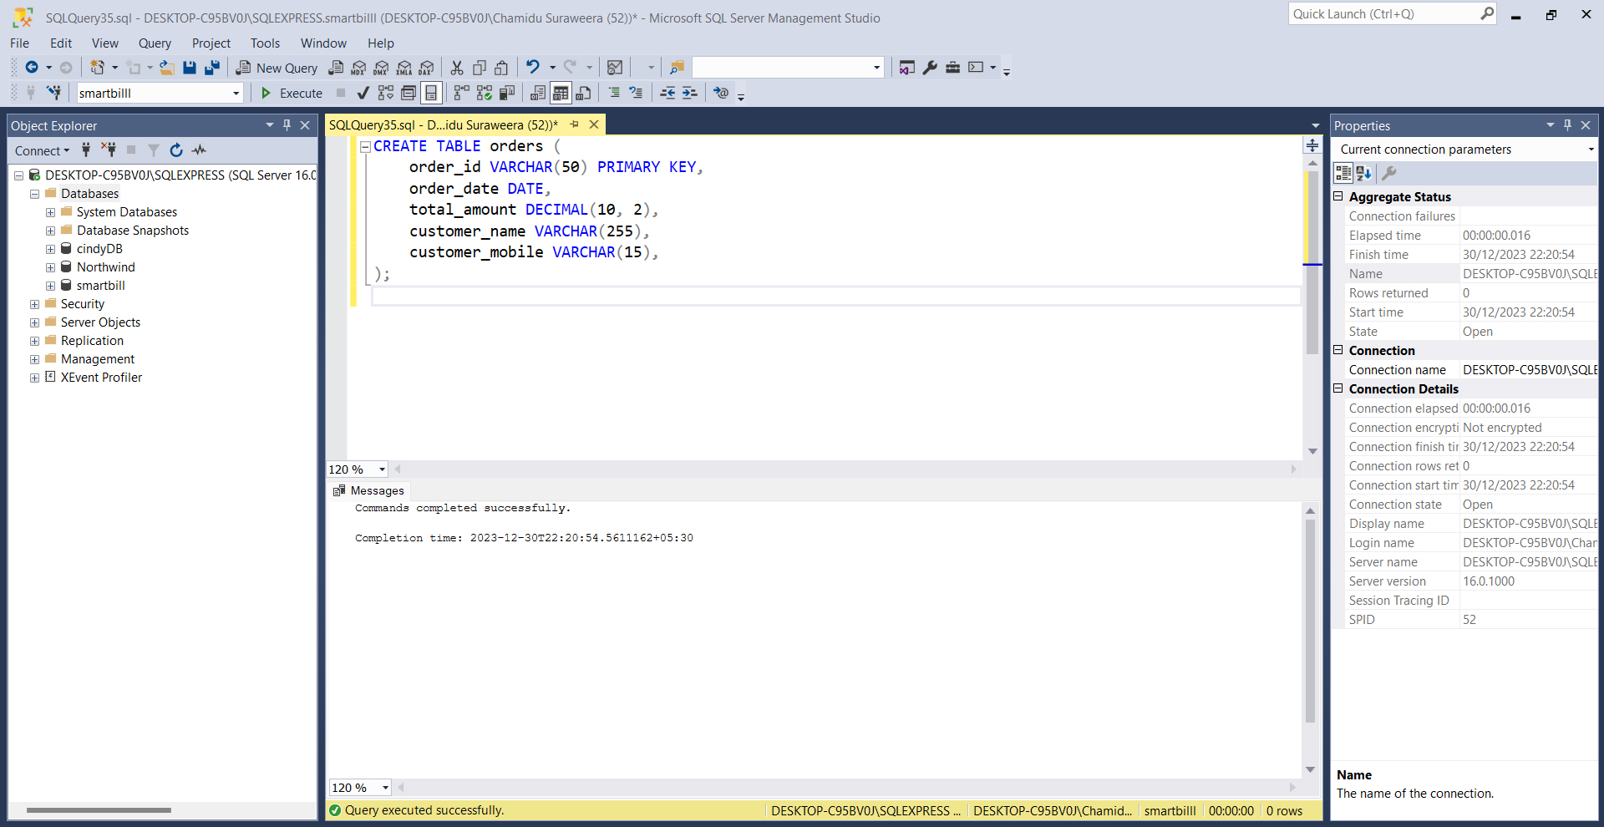
CREATE TABLE - CREATE TABLE - ORDERS
SmartBill Point of Sale System for Restaurant Management

Slide 21
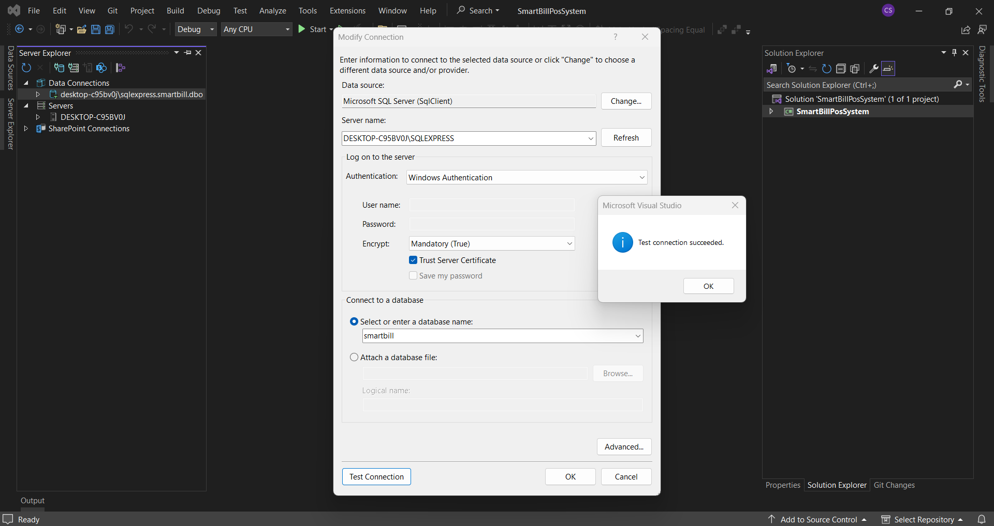
DATABASE LINKING
SmartBill Point of Sale System for Restaurant Management

Slide 22
INTERFACE CREATION

Slide 23
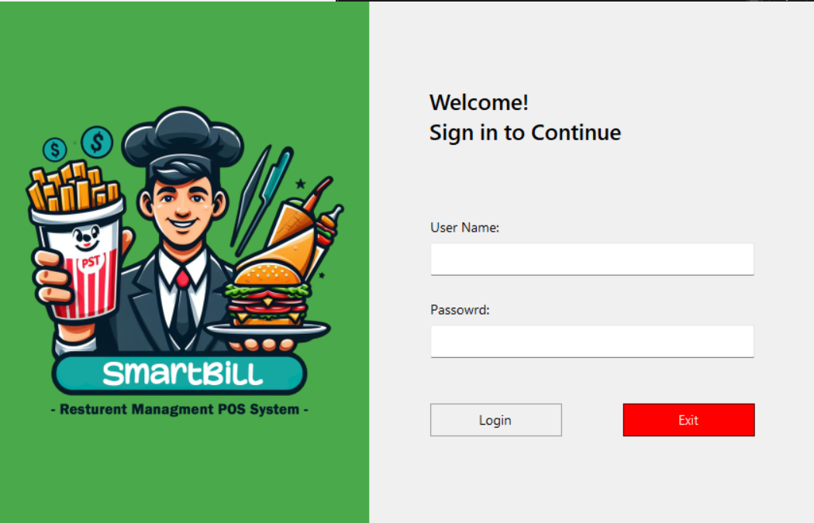
INTERFACE CREATION – LOGIN SCREEN
SmartBill Point of Sale System for Restaurant Management

Slide 24
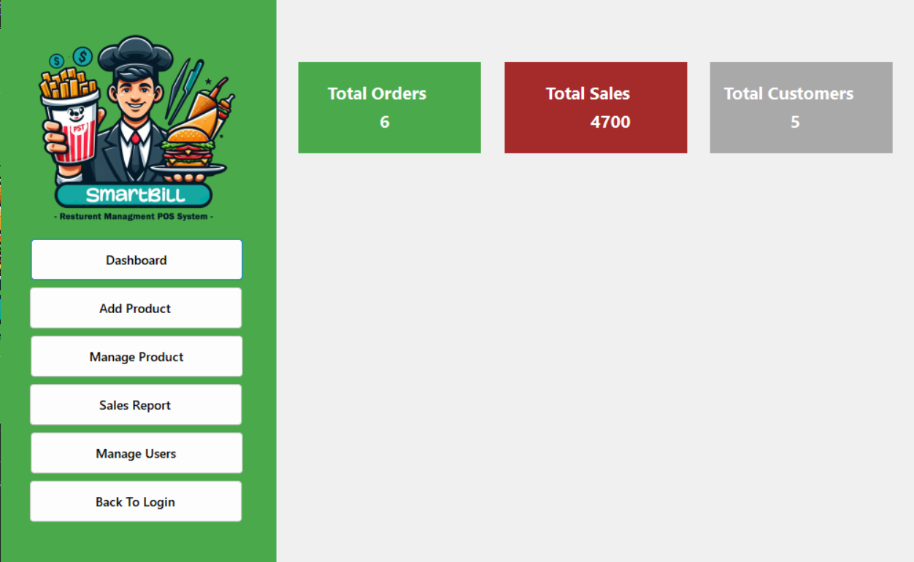
INTERFACE CREATION – ADMIN DASHBOARD
SmartBill Point of Sale System for Restaurant Management

Slide 25
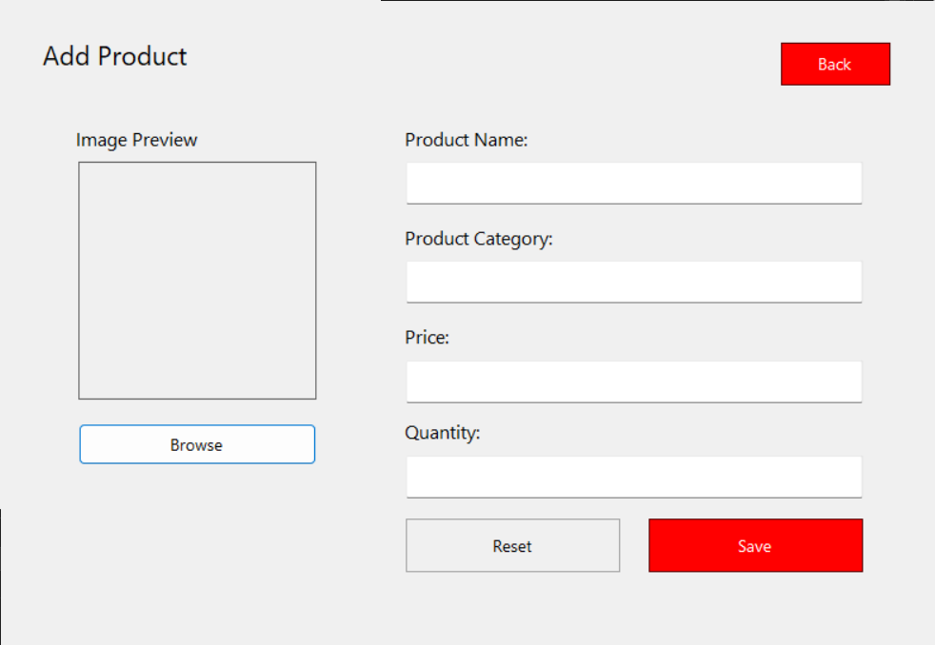
INTERFACE CREATION – ADD PRODUCT
SmartBill Point of Sale System for Restaurant Management

Slide 26
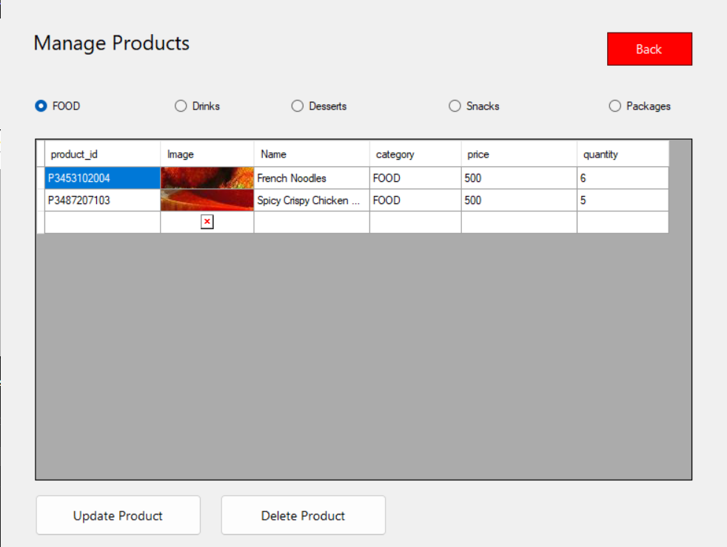
INTERFACE CREATION – MANAGE PRODUCT
SmartBill Point of Sale System for Restaurant Management

Slide 27
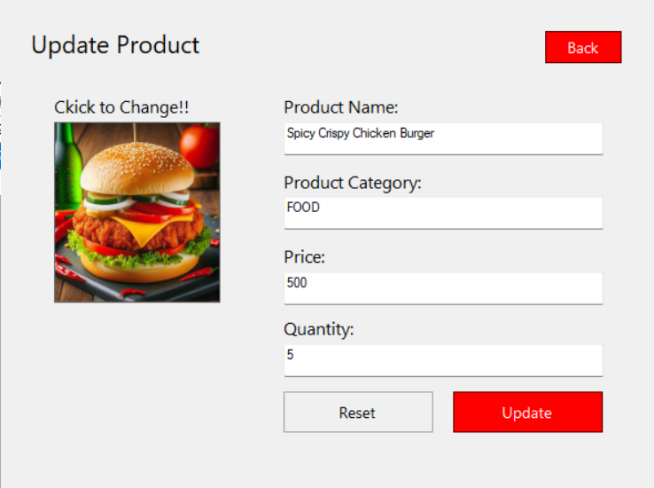
INTERFACE CREATION – UPDATE PRODUCT
SmartBill Point of Sale System for Restaurant Management

Slide 28
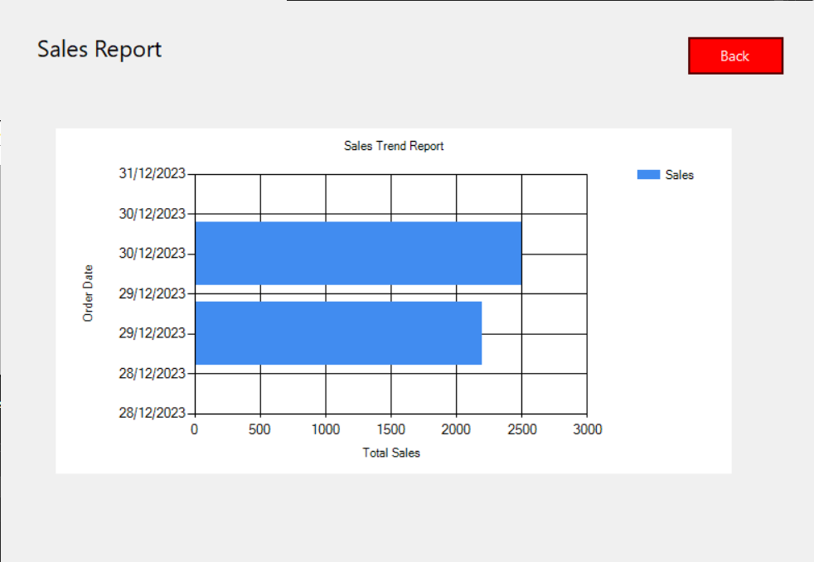
INTERFACE CREATION – SALES REPORT
SmartBill Point of Sale System for Restaurant Management

Slide 29
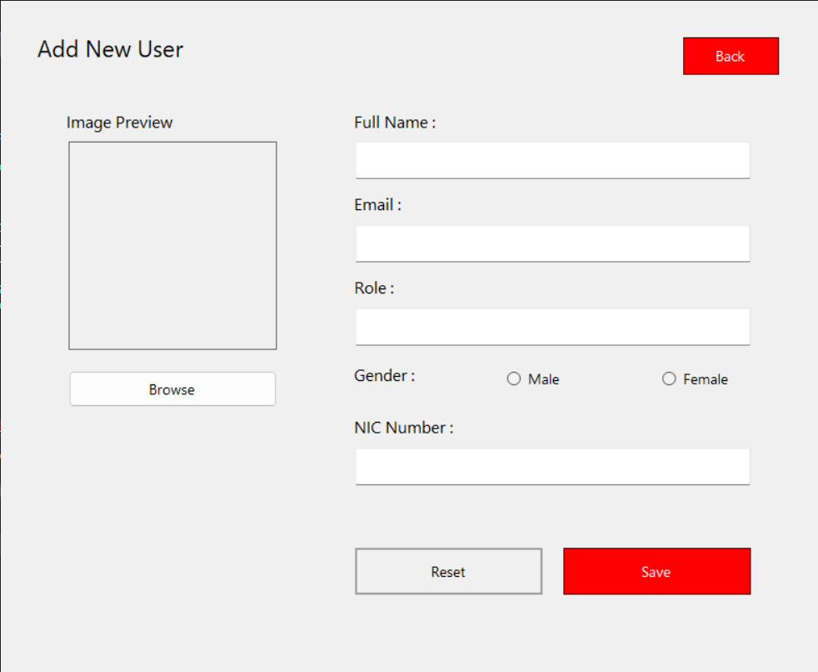
INTERFACE CREATION – ADD NEW USER
SmartBill Point of Sale System for Restaurant Management

Slide 30
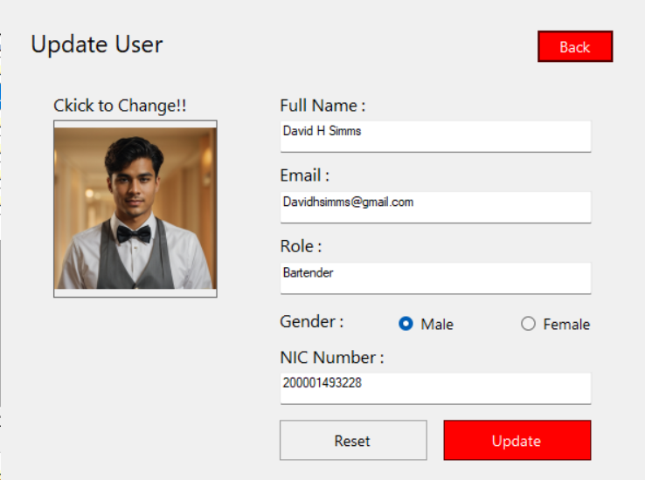
INTERFACE CREATION – UPDATE USER
SmartBill Point of Sale System for Restaurant Management

Slide 31
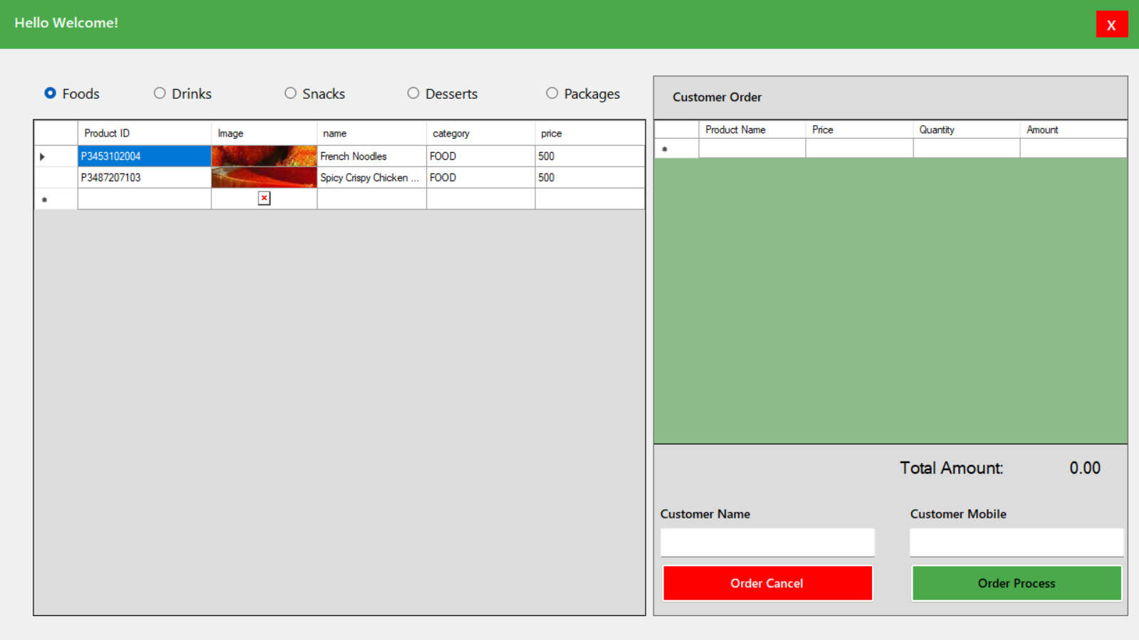
INTERFACE CREATION – CASHIER DASHBOARD
SmartBill Point of Sale System for Restaurant Management

Slide 32
WORK BREAKDOWN
Windows Form App Components
Initiation
Planning
Design
Implementation
Testing
Documentation
Select Topic
Individual task identification
System Design
Data Collecting
Unite testing
PowerPoint Presentation
Background Study
Identifying reliable technologies
Design the interfaces
Analyze data
Separate function testing
Requirement gathering & analysis
Specific objectives identification
Link interface windows
Encode core functionalities
Integrated system testing
Feasibility Study
Project proposal document creation
Create Database
Develop windows form application
Link with database
SmartBill Point of Sale System for Restaurant Management

Slide 33
SYSTEM SUMMERY
The SmartBill Point of Sales System is a WindowsForm application project designed for efficient for resturent management, Featuring Modules for,
Category and Item Managment,
Reporting,
Staff Management,
Order Processing,
And Billing
Tailored for administrator and cashiers, the user-friendly system prioritizes security, rural accessibility, and quick processing times. The project scope encompasses end-to-end design, development, testing, and implementation, with appendices detailing data and entity flow, system architecture, user interface mockups, database schema, and security measures. Stakeholder feedback and questionnaires on user experience, system performance, and security assessment contribute to ongoing improvements, ensuring the SmartBill system provides fresh, healthy products and a seamless restaurant management experience.
SmartBill Point of Sale System for Restaurant Management

Slide 34
THANK YOU!

